Slide 1
Final Portfolio Project on SQL Part Topic : Comprehensive E-commerce Data Management and Analysis
Presentor: Sumiya Sadiya
Course Name : Data & Business Analytics Live

Slide 2
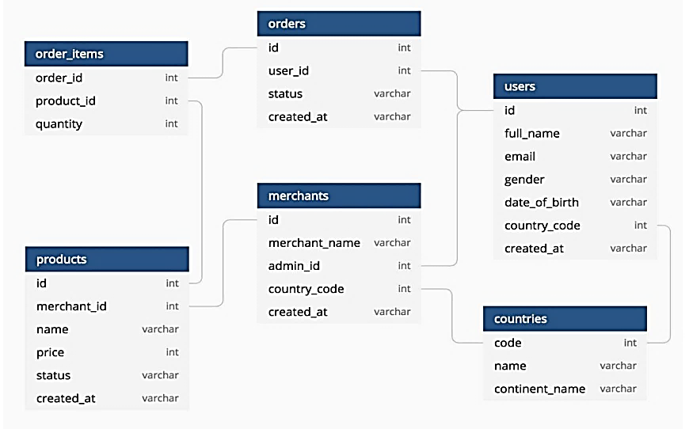
Project Schema: eCommerce_DB

Slide 3

Basic Queries

Slide 4
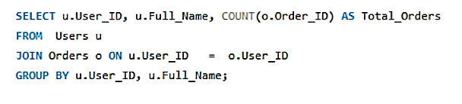
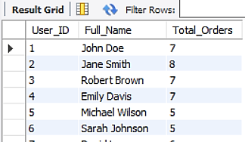
1. Write a query to display the total number of orders made by each user.
MySQL Code
Output
Users who are highly engaged with the business could be targeted for loyalty programs or retention strategies.
Regular customers could be encouraged through targeted marketing campaigns or discounts to increase their order frequency

Slide 5
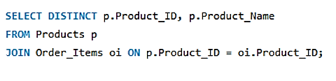
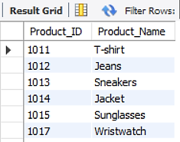
2. Write a query to display the names of products that have been ordered at least once.
MySQL Code
Output
Business should monitor their stock levels closely to avoid upcoming shortages.
In future, implementing bundling strategies can encourage customers to purchase related products together to increase the overall order value.

Slide 6
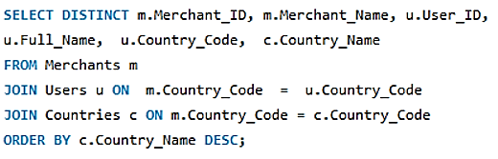
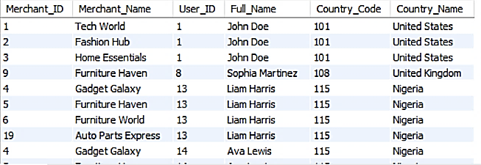
3 . Retrieve the details of all users who are from the same country as the merchant
MySQL Code
Output
Strengthen local marketing campaigns, businesses should prioritize country-specific marketing strategies, fast local delivery, country-specific products, and customer testimonials..
In future, it is recommended introducing customer loyalty programs based on purchase history can help retain local users and encourage repeat purchases..

Slide 7
Aggregate Functions: (SUM, AVG, COUNT, MIN, MAX)

Slide 8
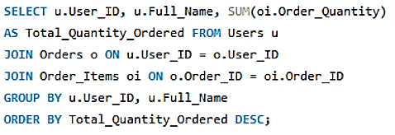
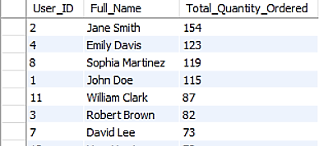
1. Calculate the total quantity of products ordered by each user.
MySQL Code
Output
Highest-volume customers, ordering between 115 and 154 products. In future, engaging with these users through personalized promotions or loyalty programs could increase retention and drive further sales.
lowest-volume customers, re-engagement strategies, such as sending personalized offers or providing incentives for repeat purchases, could help retain these customers.

Slide 9
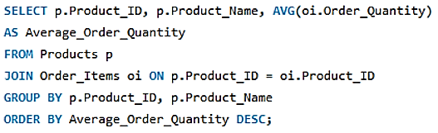
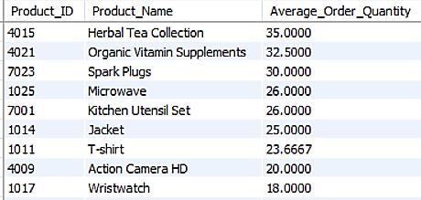
2. Find the average order quantity for each product.
MySQL Code
Output
By analyzing the average order quantities for each product, businesses can better manage their inventory, optimize pricing strategies.
Tailor marketing efforts to maximize sales and enhance the customer experience.

Slide 10
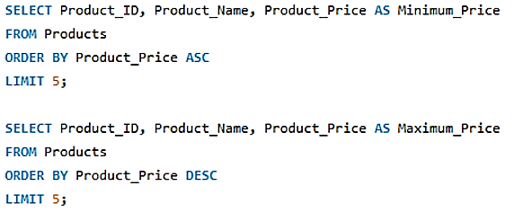
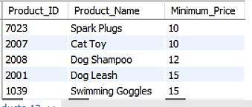
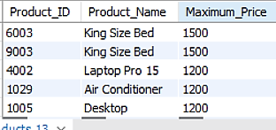
3. Determine the minimum and maximum prices of the products.
MySQL Code
Output
If there’s a gap in the product offerings between the lowest and highest prices, consider developing products that could appeal to middle-market consumers, potentially increasing market share.
Use price segmentation to more effectively target marketing and sales efforts.

Slide 11
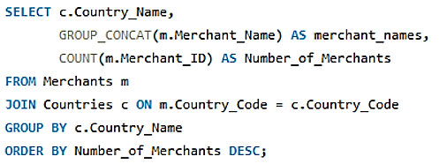
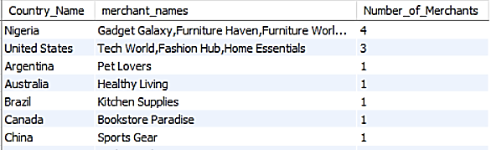
4. Count the total number of merchants operating in each country.
MySQL Code
Output
High competition in Nigeria with 4 merchants could be more competitive. They need to differentiate their offerings and provide superior customer service to gain market share.
Differentiation through unique product offerings, local partnerships, and customer experiences will be challenging for success .

Slide 12
Group By & Having Clauses

Slide 13
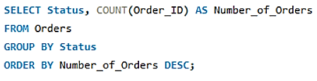
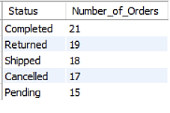
1. Group the orders by their status and count the number of orders in each status
Code
Output
Having the highest number of orders in the "Completed" status (21 orders) suggests that the order processing system is functioning well, and most customers are satisfied with the overall experience.
Put focus on retain customers by providing incentives (e.g., loyalty programs, discounts on future purchases)..

Slide 14
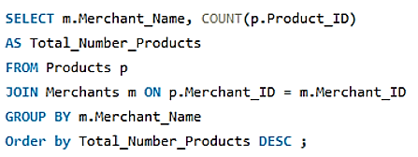
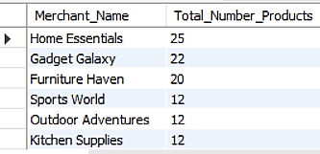
2. Group the products by merchant and display the total number of products offered by each merchant.
MySQL Code
Output
Home Essentials , Gadget Galaxy lead a wide range of offerings, making them a significant player in the marketplace..
Have to put focus on Tech World with the smallest product count. It could also reflect a more niche market focus.

Slide 15
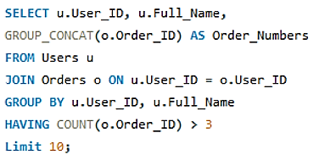
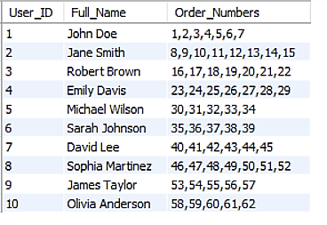
3. Show the users who have placed more than 3 orders.
MySQL Code
Output
Users who have placed more than three orders, providing valuable insights into repeat customers.
Put focus on retain users by providing incentives (e.g., loyalty programs, discounts on future purchases) and drive sales through repeat purchases.

Slide 16
SQL Joins

Slide 17
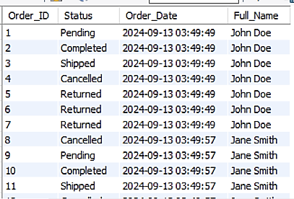
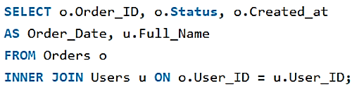
1 . Perform an inner join between orders and users to retrieve all the orders along with the user's full name
MySQL Code
Output
Analyzing frequent order statuses per customer may provide insights into specific customer behavior.
Specially, return items need for targeted customer service interventions or improved product offerings.

Slide 18
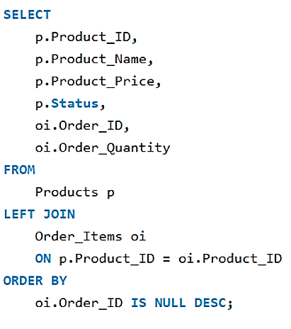
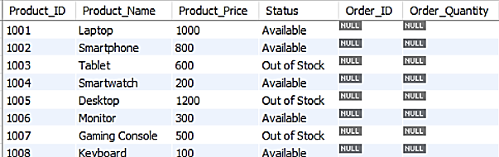

2. Use a left join to retrieve all products and their respective orders. Include products that haven’t been ordered.
Many products appear without any associated orders (indicated by NULL in Order_ID), signaling that these items may be underperforming.
The business might consider reviewing their marketing strategy for these products or even discontinuing them.

Slide 19
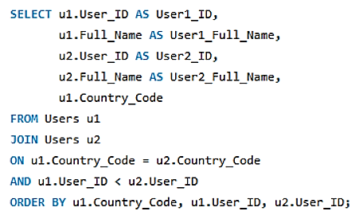
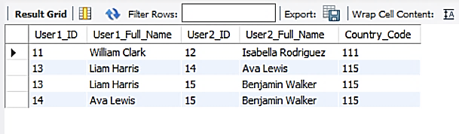
3. Use a self-join to find users who share the same country code.
This can help tailor regional marketing campaigns, personalized offers, or customer support strategies based on geographic location.Put focus on retain customers by providing incentives (e.g., loyalty programs, discounts on future purchases)..
Users from the same country may share cultural or regional preferences to foster community building through region-specific engagement, social features, or events.

Slide 20
Window Functions (Aggregate Functions)

Slide 21
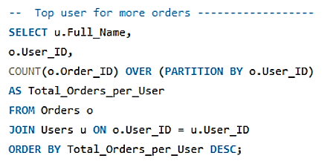
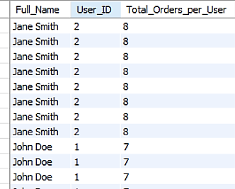
1. Calculate the total number of orders for each user using a window function.
MySQL Code
Output

Slide 22
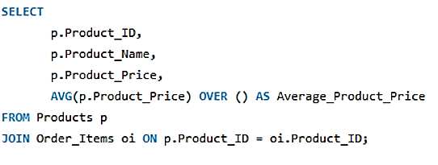
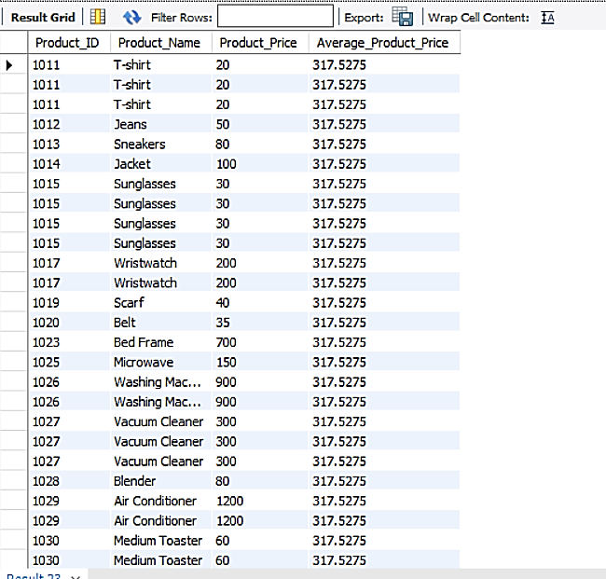
2. Calculate the average price of products over all orders using a window function..
MySQL Code
Output
By computing the overall average price help in determining if certain products are overpriced or underpriced relative to the overall product portfolio.
Helping in adjusting prices to optimize revenue, ensuring that products meet market demand and profitability goals.

Slide 23
Window Functions (Ranking)

Slide 24
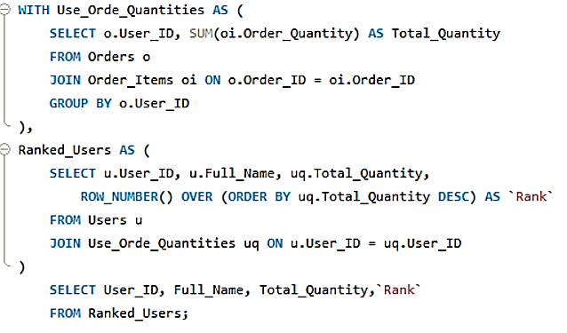
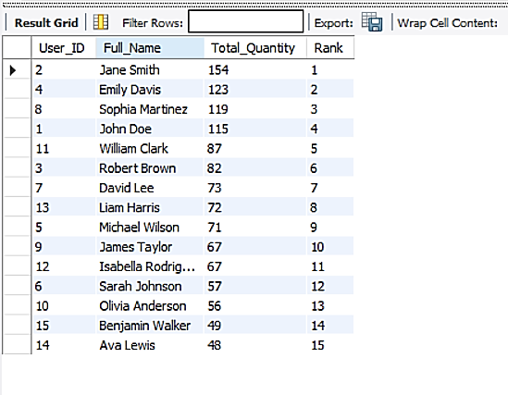
1. Rank the users based on the total quantity of products ordered using ROW_NUMBER().
MySQL Code
Output
The most active or high-value customers, who are crucial for driving sales volume. These users may represent a significant portion of revenue.
The ranking provides insight into which customers may benefit from loyalty programs, targeted promotions

Slide 25
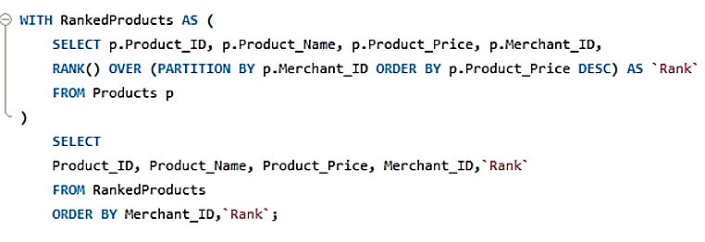
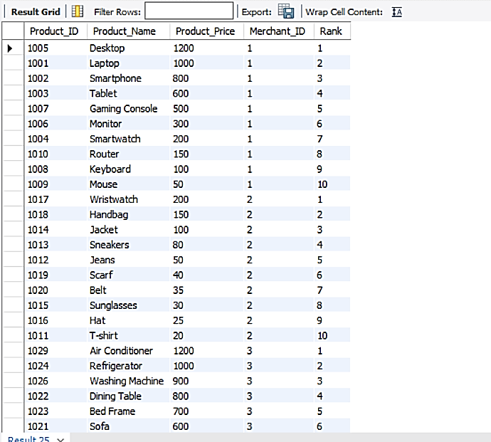
2. Use RANK() to rank products based on their price within each merchant
MySQL Code
Output
Merchants can focus on high-ranking products (the most expensive) for premium customers and ensure these items are well-stocked and promoted.
For lower-ranking, affordable products, merchants can target price-sensitive customers and optimize for volume sales.

Slide 26
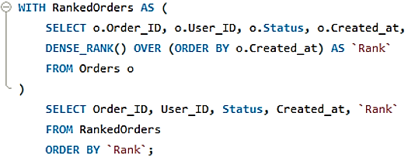
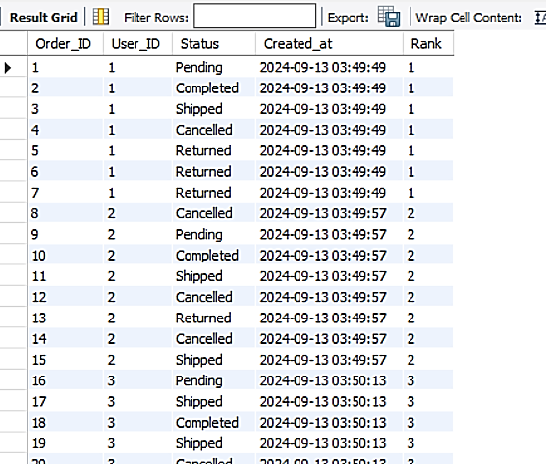
3. Determine the DENSE_RANK() of orders by their created date.
MySQL Code
Output
Dense ranking helps identify patterns in order creation and lifecycle progression, enabling businesses to improve fulfillment efficiency, customer service, and system performance..

Slide 27
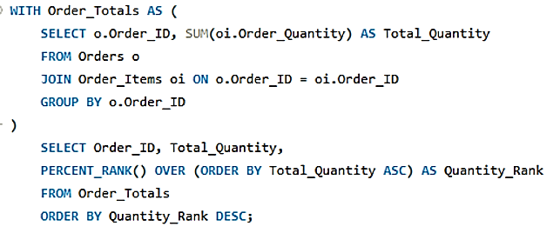
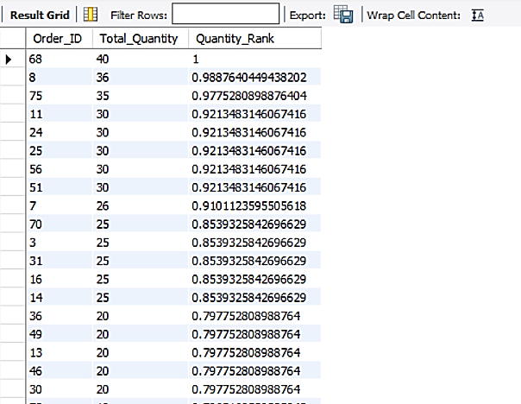
4 . Use PERCENT_RANK() to find the rank of orders by their quantity compared to the overall total.
MySQL Code
Output
This analysis helps to understand how orders compare in size relative to the total quantity distribution across all orders.For lower-ranking, affordable products, merchants can target price-sensitive customers and optimize for volume sales.
By understanding the PERCENT_RANK() , businesses can optimize inventory, pricing strategies, and customer segmentation.

Slide 28
Window Functions (Value/Analytic)

Slide 29
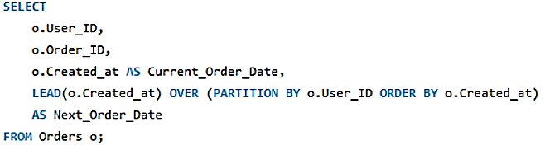
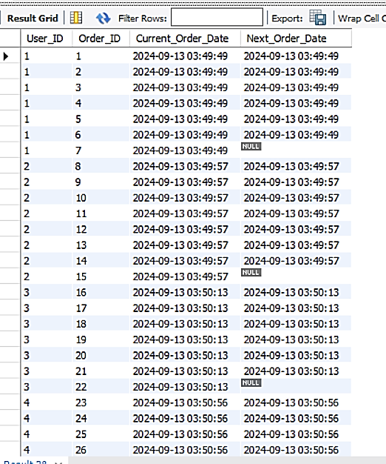
1. Use LEAD() to find the next order date for each user
MySQL Code
Output
Analysis concept here involves customer purchase behavior analysis by using the LEAD() function to find the next order date for each userFor lower-ranking, affordable products, merchants can target price-sensitive customers and optimize for volume sales.
Helping in identify customer purchase patterns, which is critical for improving retention strategies, inventory management,.

Slide 30
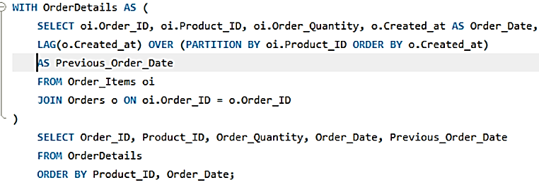
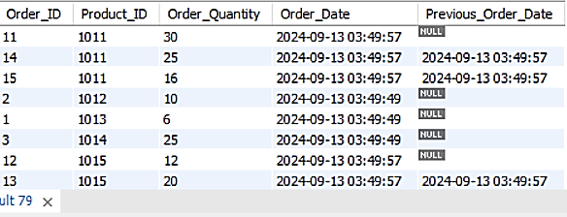
2. Use LAG() to determine the previous order for each product.
The Previous_Order_Date column helps identify how frequently a product is reordered. For instance, products with NULL in this column were being ordered for the first time.
By analyzing the gaps between the Order_Date and Previous_Order_Date, we can gauge demand consistency for each product.

Slide 31
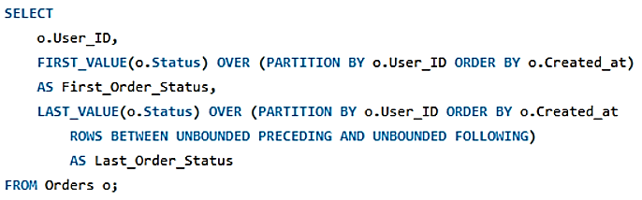
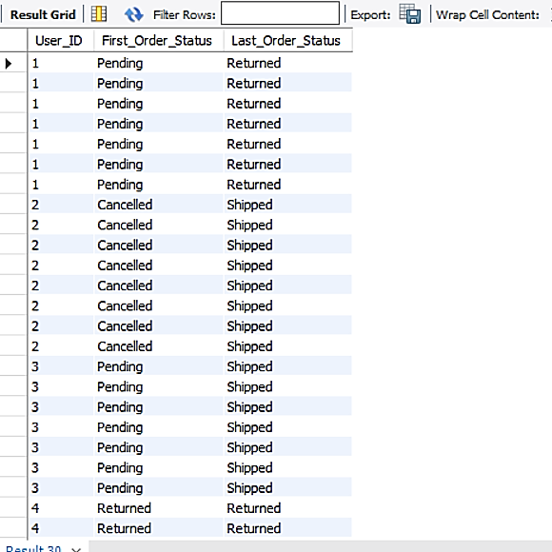
3. Retrieve the FIRST_VALUE() and LAST_VALUE() of order statuses for each user.
MySQL Code
Output
The goal is to analyze the transition of order statuses over time for individual users.For lower-ranking, affordable products, merchants can target price-sensitive customers and optimize for volume sales.

Slide 32
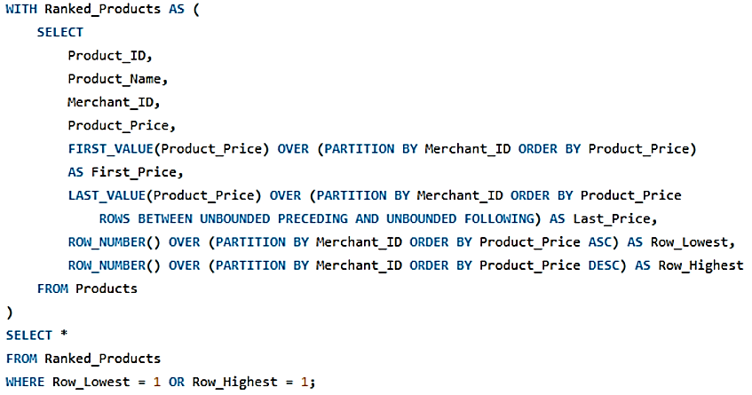
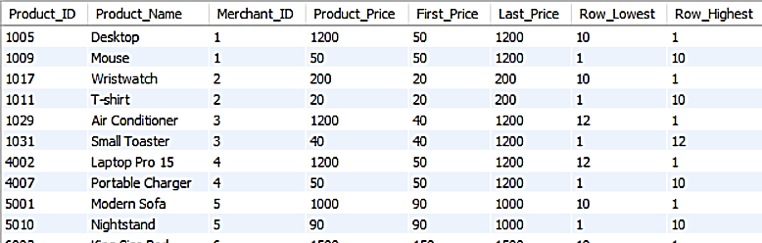
4. Find the FIRST_VALUE() and LAST_VALUE() of prices in each product category.

Slide 33
Subqueries

Slide 34
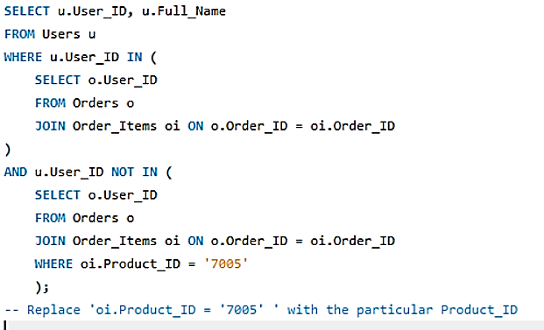
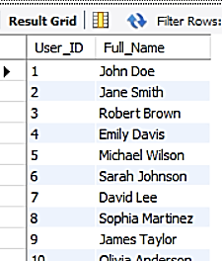
1. Write a subquery to find the users who have placed orders but have not ordered a particular product.
MySQL Code
Output
Businesses can target these users for specific marketing efforts, such as promotions or recommendations.
This insight allows businesses to improve communication or reposition the product to attract this segment.

Slide 35


2. Use a correlated subquery to find users who have placed more orders than the average number of orders. .
MySQL Code
Output
This query helps businesses identify high-value customers who are placing more orders than the average user.For lower-ranking, affordable products, merchants can target price-sensitive customers and optimize for volume sales.
Businesses can design retention strategies that keep these valuable customers

Slide 36
Case Statements

Slide 37


1. Write a query to categorize products into 'Low Price', 'Medium Price', and 'High Price' based on their price.
MySQL Code
Output
By segmenting products into price categories, businesses can better understand their pricing structure and identify how their products align with market expectations..
This segmentation aids in personalized marketing and promotions.

Slide 38


2. Create a case statement that categorizes users as 'New', 'Regular', or 'VIP' based on the number of orders they have placed.
MySQL Code
Output
Businesses can use this insight to track the progression of customers through different categories, ensuring effective strategies to move 'New' customers to 'Regular', and 'Regular' to 'VIP'.

Slide 39
Time-Related Operations

Slide 40


1 . Extract the year and month from the created_at date of orders.
MySQL Code
Output
Businesses can conduct monthly and yearly trend analysis. This allows for tracking seasonal patterns, spikes, or declines in ordersFor lower-ranking, affordable products, merchants can target price-sensitive customers and optimize for volume sales.

Slide 41


2 . Calculate the difference in days between the first and last order of each user.
Output
MySQL Code
A longer difference implies higher engagement, while a shorter one could indicate one-time or short-term customers.
Analyzing the average time between orders can reveal customer behavior and predict when they might make their next purchase.

Slide 42


3 . Use DATE_PART() to extract the day of the week from the created_at column for all orders.
MySQL Code
Output
Insights into order trends by weekday can help refine sales strategies, like launching flash sales or discount offers on slower days to boost activity.For lower-ranking, affordable products, merchants can target price-sensitive customers and optimize for volume sales.

Slide 43
Common Table Expressions (CTE)

Slide 44


1 . Write a CTE to calculate the cumulative total of products ordered by each user
MySQL Code
Output
Analyzing cumulative orders can help design effective loyalty programs. Users with high totals may be targeted for exclusive rewards or recognition, fostering customer retention.

Slide 45


2 . Use a CTE to find the top 5 users with the highest number of orders.
MySQL Code
Output
Top users helps recognize high-value customers who significantly contribute to revenue.For lower-ranking, affordable products, merchants can target price-sensitive customers and optimize for volume sales.
Analyzing order counts can serve as a metric for evaluating sales team performance

Slide 46
Summary Analysis
Total Orders: Jane Smith placed the most orders (8), followed by John Doe (7), William Clark (6), and Isabella Rodriguez (5).
User Engagement: All users placed more than 3 orders during the analysis period.
Average Order Quantity: The average order quantity for the "Herbal Tea Collection" is 35 units, making it the product with the highest order volume.
Ranking: Jane Smith ranks 1st for total quantity ordered (154 units), with Emily Davis ranking 2nd (123 units), calculated using the ROW_NUMBER() function.
Merchant Activity: The most active merchants are from Nigeria (country code 115) and the United States (country code 101).
Price Range: Product prices range from a minimum of $10 to a maximum of $1,500.
Top Product Quantities: Jane Smith (154) and Emily Davis (123) secured the highest positions for the total quantity of products ordered.
Product Offerings: "Home Essential" offers 25 products, while "Gadget Galaxy" offers 22 products on the platform.
Average Product Price: The average product price across all orders is $317.52.
Product Categories: Products are categorized by price: low price (below $500), medium price ($500-$900), and high price (above $900). All orders were placed in September 2024.

